Slide 2

Welcome

Slide 3
Thinking Outside the Box(plot)
#Data17
Rob Barnhart & Paul Szilard
Product Consultants
Tableau

Slide 4

Rob Barnhart
#Data17
Product Consultant
Rbarnhart@tableau.com

Slide 5

Rob Barnhart
#Data17
Formerly a white water rafting guide
My parents are also in this picture…

Slide 6

Paul Szilard
#Data17
Senior Product Consultant & Customer Consulting Trainer
PSzilard@tableau.com

Slide 7

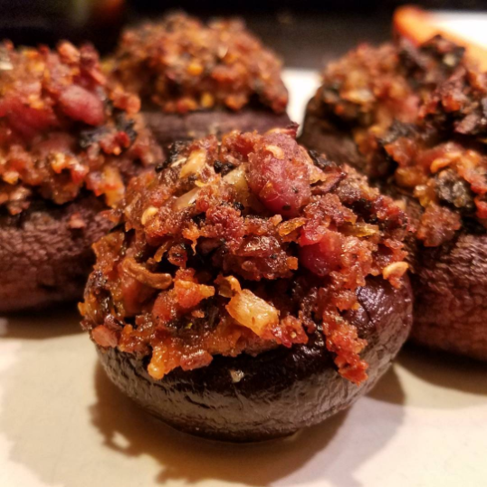
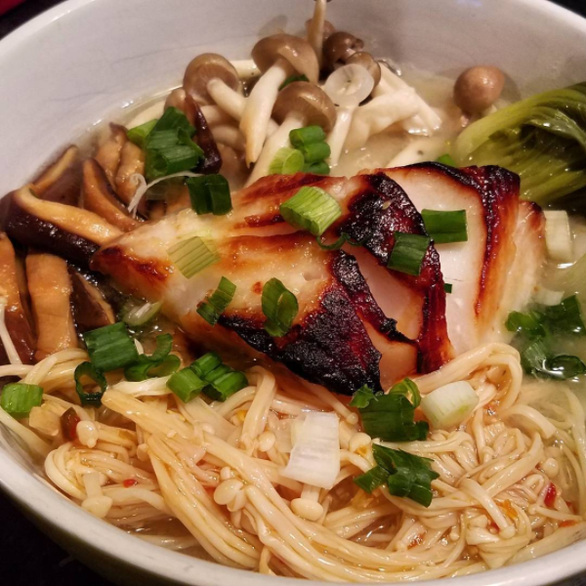
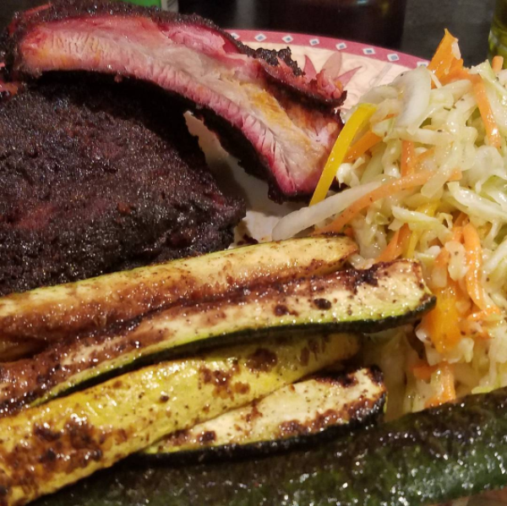
Paul Szilard
#Data17
Formerly a human resources consultant
Believes if you are going to eat, you might as well eat something delicious

Slide 8
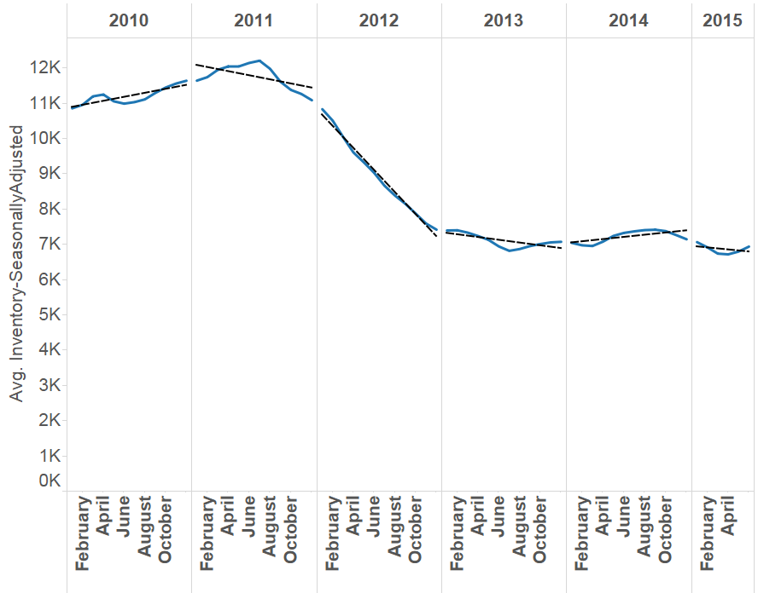
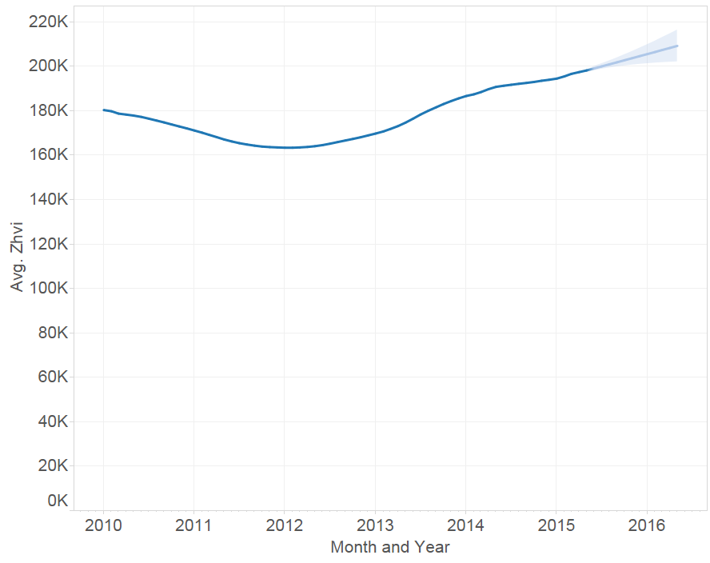
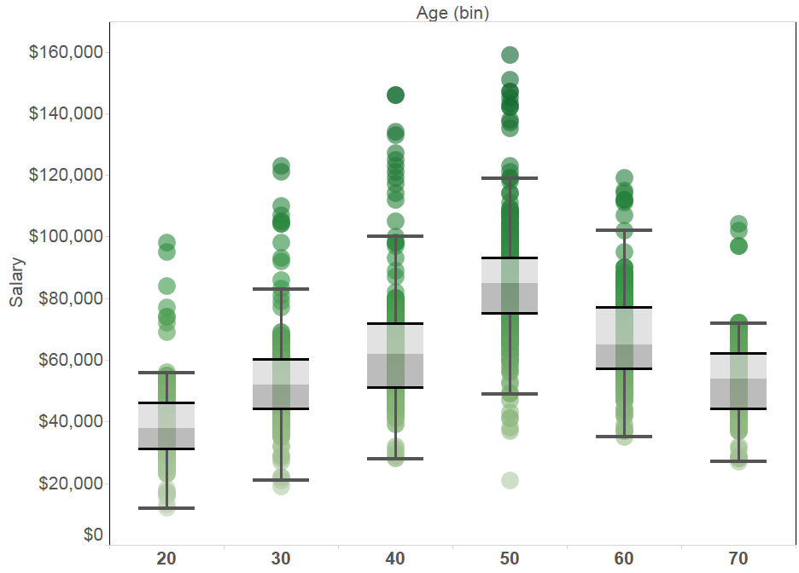
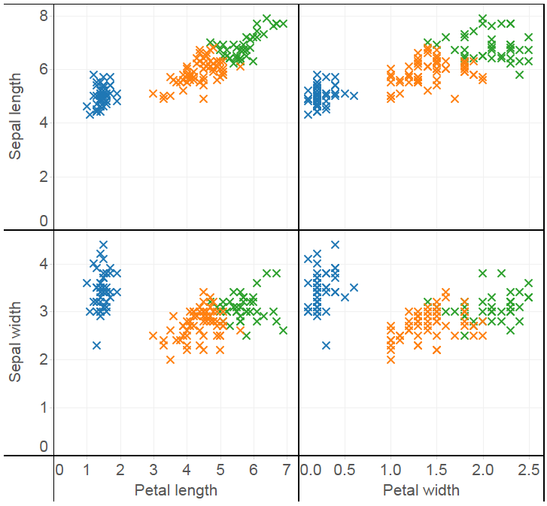
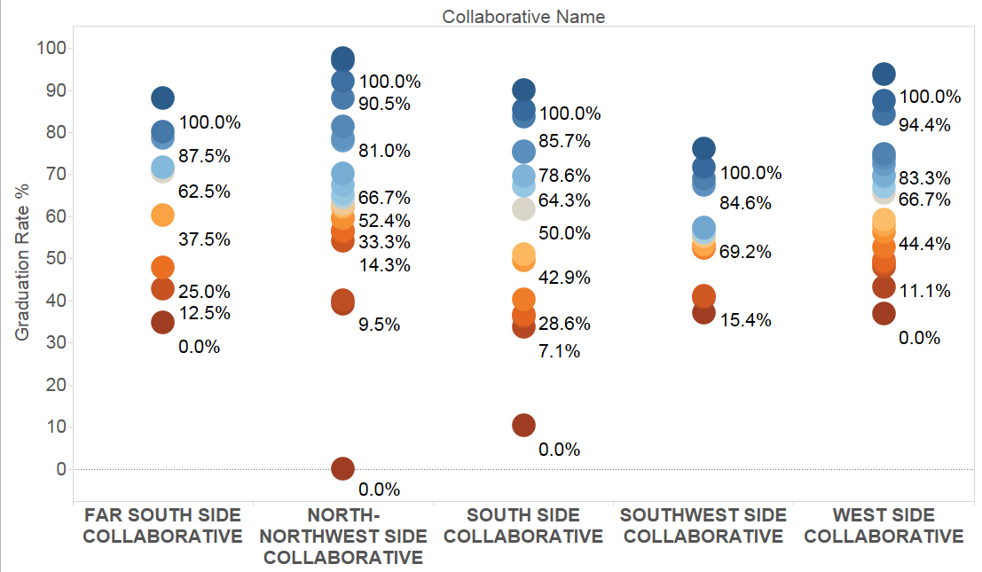
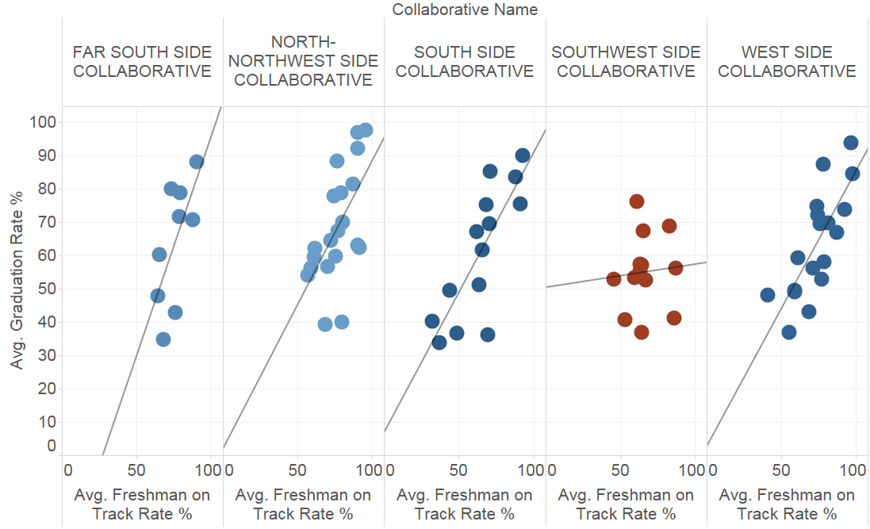
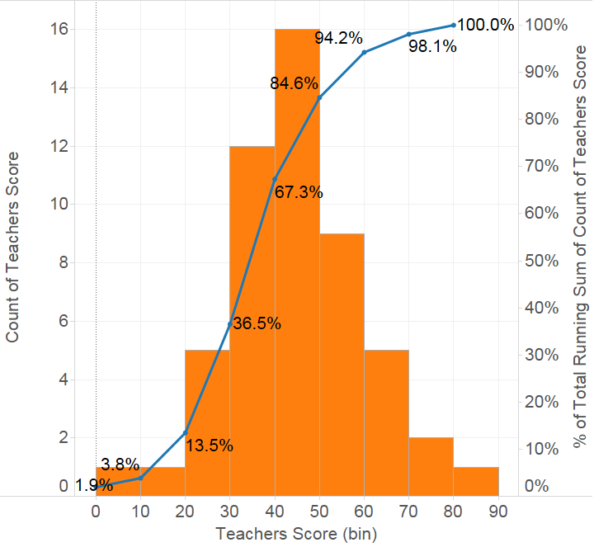
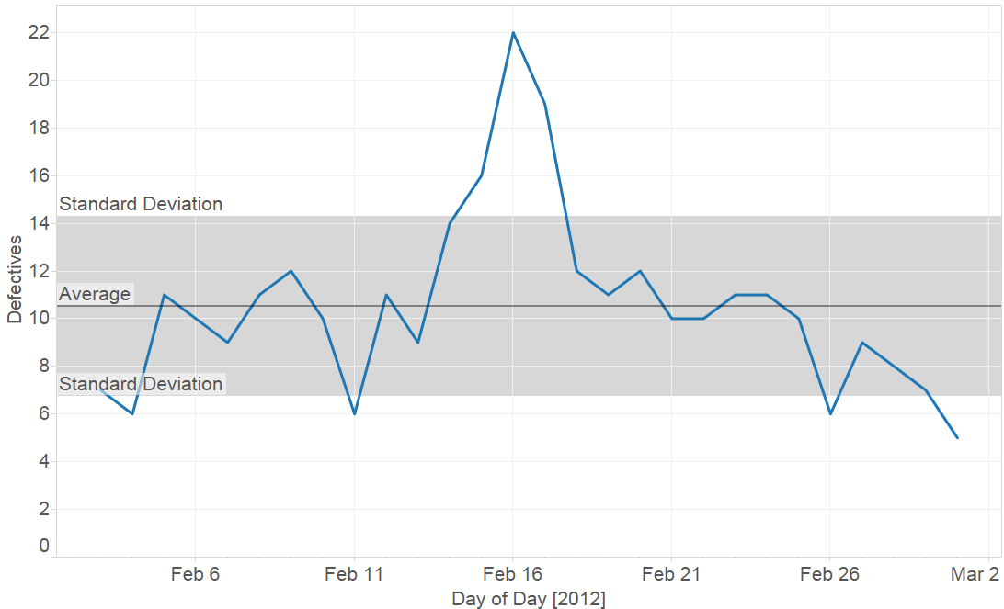
Agenda
Notes:
Histograms (Tableau Experience) Paul
Percentiles, Distributions/Summary Card (Quiz Scores) Rob
Box Plots (Compensation) Paul
What’s a Box Plot in Tableau?
Control Chart (Manufacturing Defects) Rob
Trend Lines (Housing) Paul
Trend Models
Correlation and Covariance Rob
Forecasting (Housing) Paul
Forecasting Options, Models
Clustering (Flowers) Rob
Clustering Model/K-Means:

Slide 9
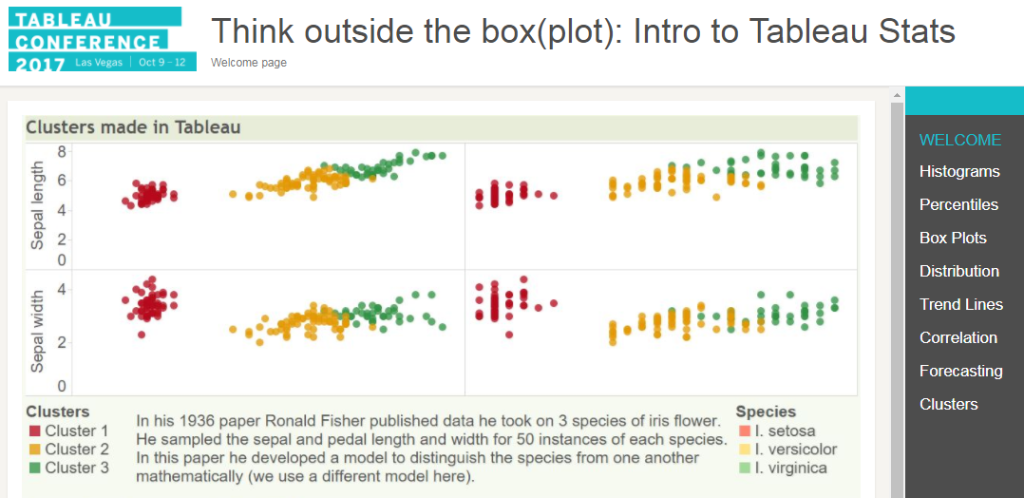
The Guided Website
Select the HTML Document file titled “Welcome”

Slide 10
Distribution

Slide 11
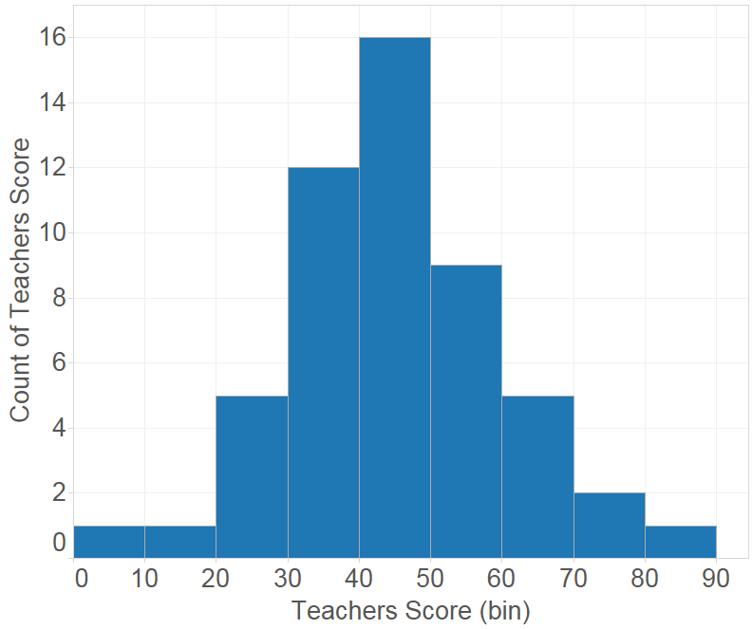
Histograms
Histograms show us the distribution of numerical data

Slide 12
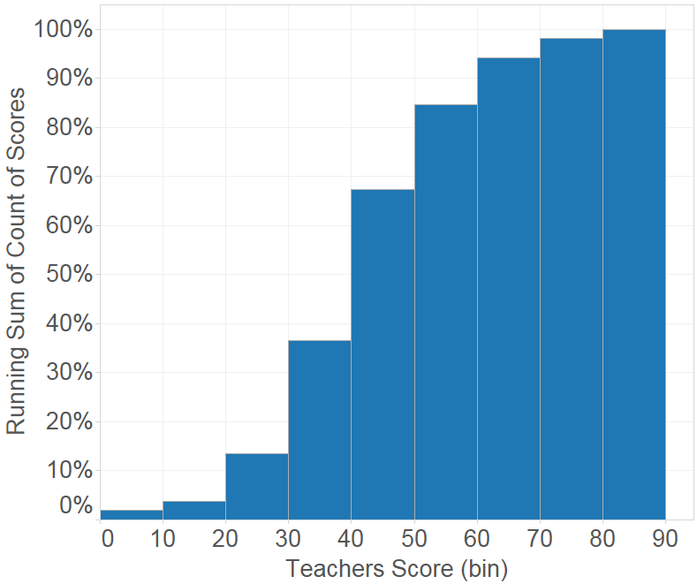
Histograms
Basic Histogram
Cumulative Histogram

Slide 13
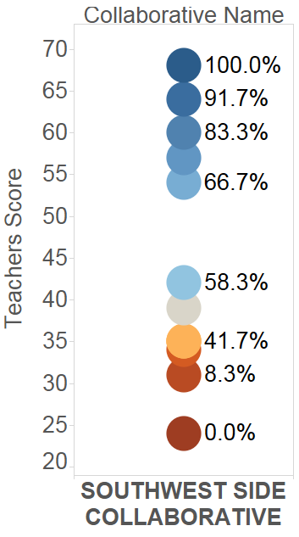
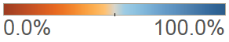
Percentiles
Percentiles indicate the value below which a given percentage of the observed data falls.
Ex: If a school is in the 66.7th percentile, their teacher score is better or stronger than 2/3 of compared schools.
Percentile of Teachers Score

Slide 14
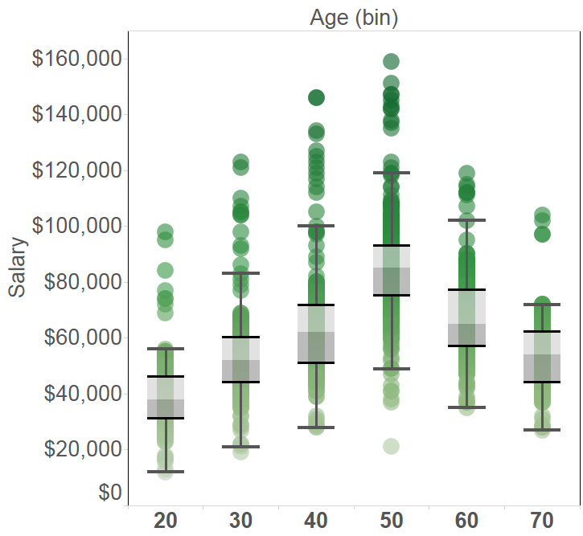
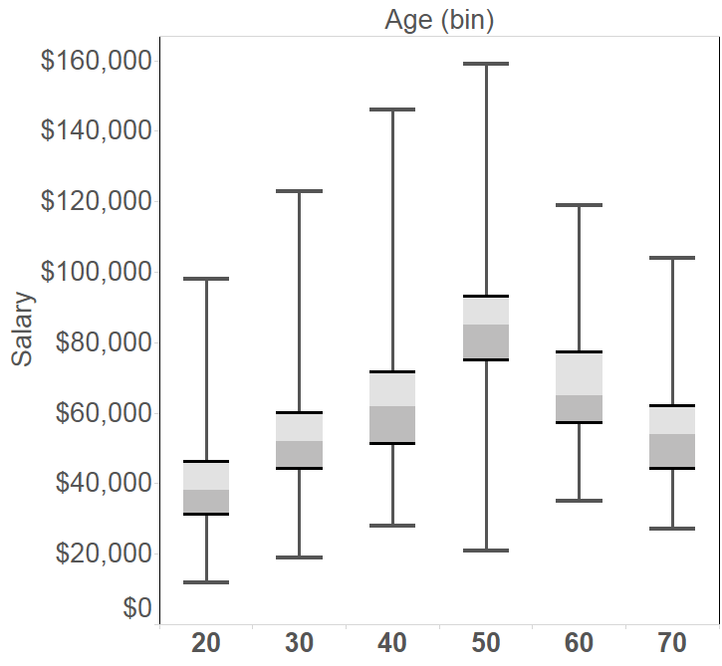
Box Plots
Tableau Box Plot
Traditional Box Plot

Slide 15
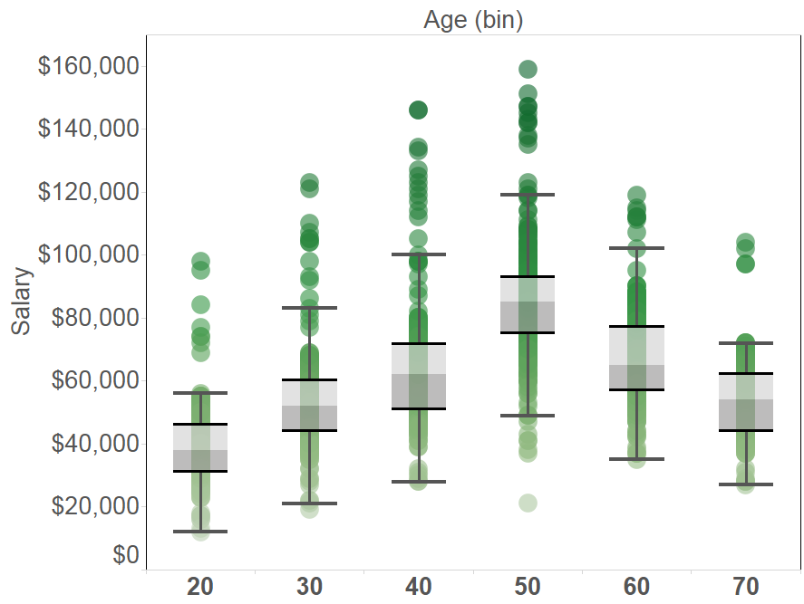
Anatomy of the Tableau Box Plot

Slide 16
Anatomy of the Tableau Box Plot
Interquartile Range

Slide 17
Anatomy of the Tableau Box Plot
1.5 times the IQR

Slide 18
Anatomy of the Tableau Box Plot
Outliers!

Slide 19
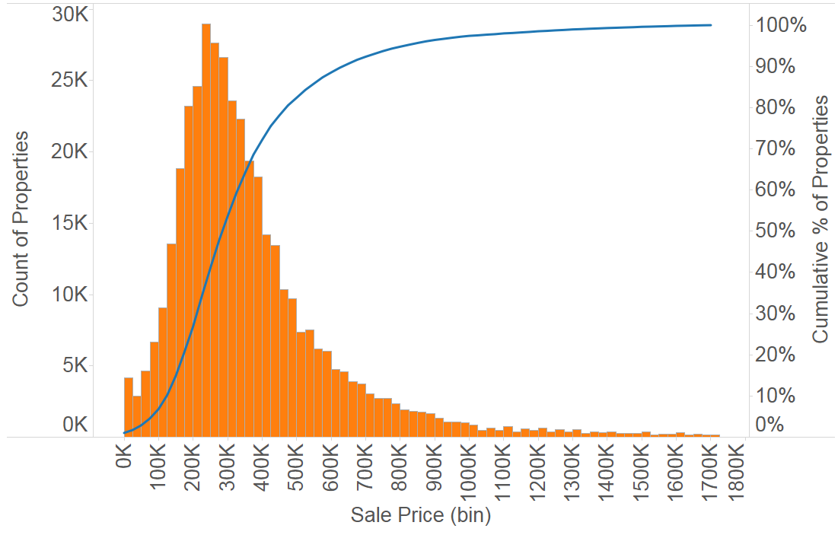
Summary Card - Skewness

Slide 20
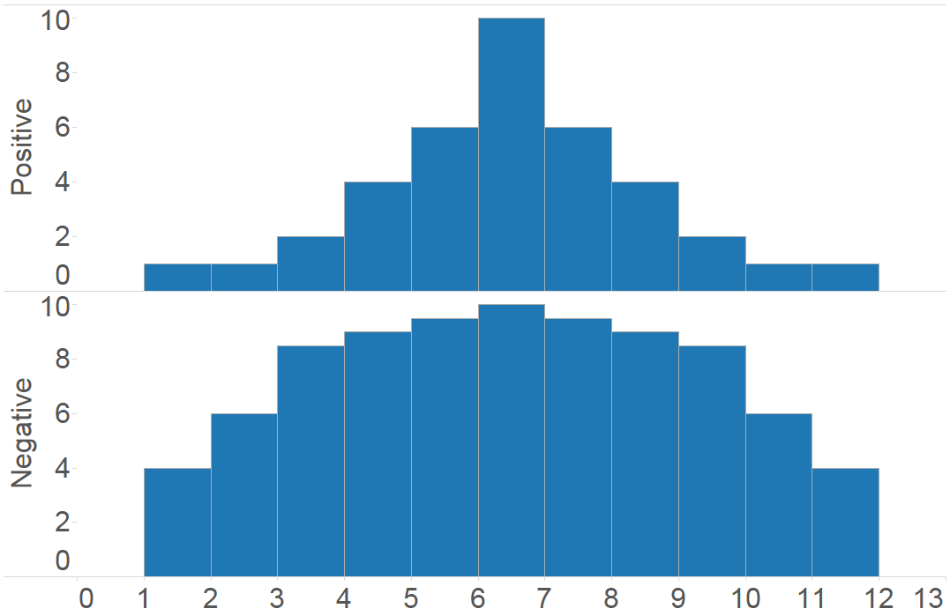
Summary Card - Kurtosis
Positive Excess Kurtosis
Negative Excess Kurtosis

Slide 21
Modulo (%)
Entry | Remainder (Result)
1 % 5 | 1/5 → 1
2 % 5 | 2/5 → 2
3 % 5 | 3/5 → 3
4 % 5 | 4/5 → 4
5 % 5 | 5/5 (1) → 0
6 % 5 | 6/5 → 1
7 % 5 | 7/5 → 2
8 % 5 | 8/5 → 3
9 % 5 | 9/5 → 4
10 % 5 | 10/5 (2) → 0
Modulo is written X % Y and returns the remainder of X / Y, where X and Y are integers.
We can use Modulo to:
Determine whether a number is odd or even
Perform time calculations
Group values arbitrarily

Slide 22
Modeling

Slide 23
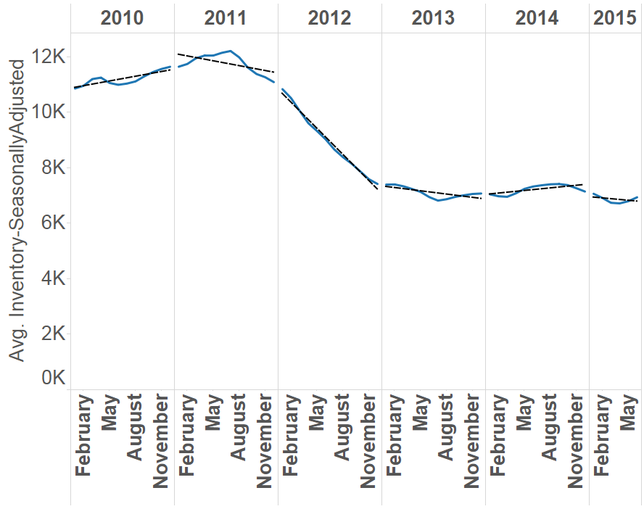
Trend Lines
Options
Linear
Exponential
Logarithmic
Polynomial
Avg. Inventory = -313 * Month + 10,985

Slide 24
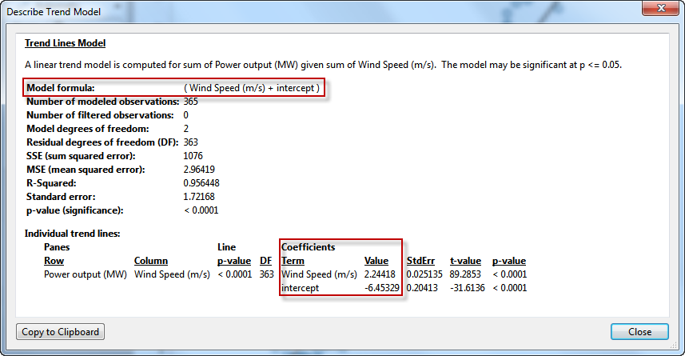
Trend Models

Slide 25
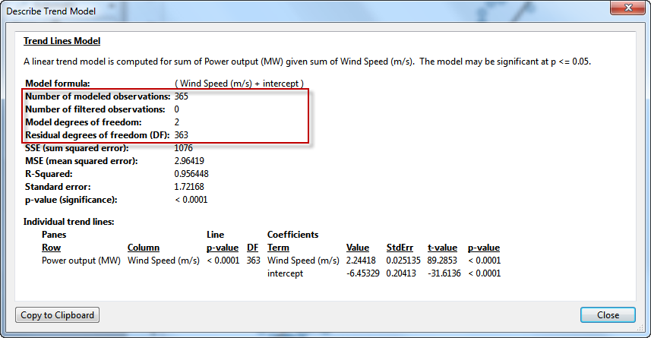
Trend Models

Slide 26
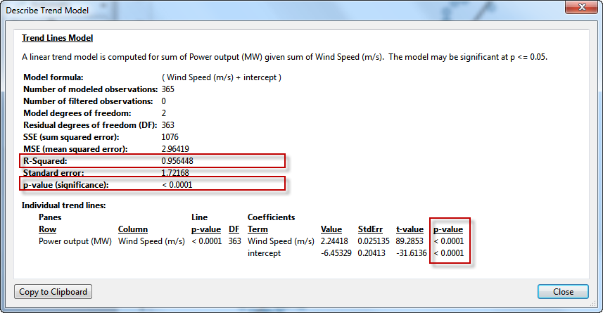
Trend Models

Slide 27
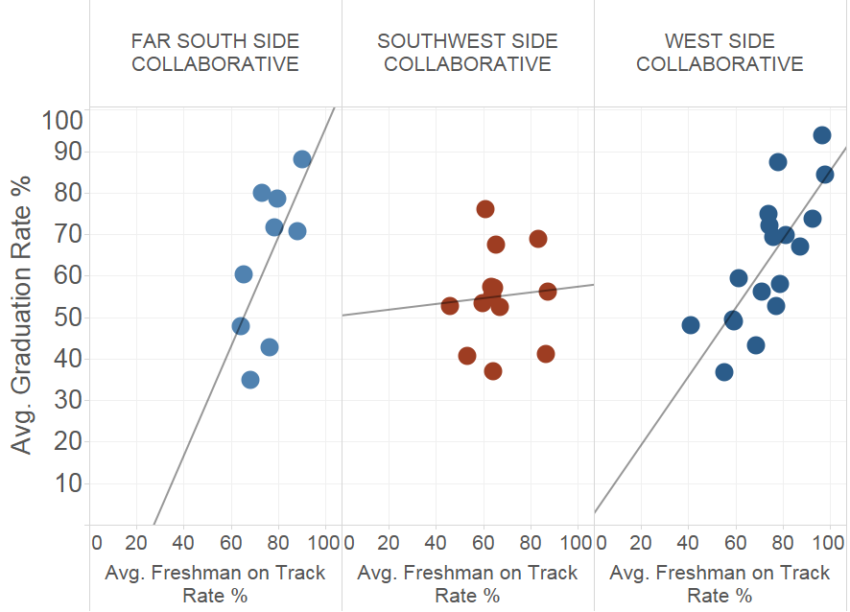
Correlation Coefficient
Pearson’s correlation coefficient is a measure of the strength and direction of the linear relationship between two variables

Slide 28
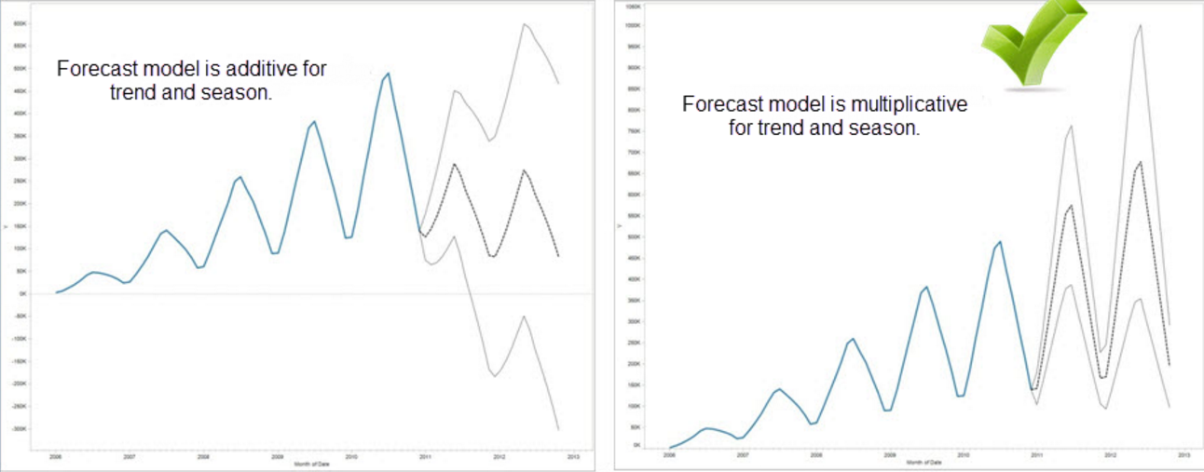
Forecasting Models

Slide 29
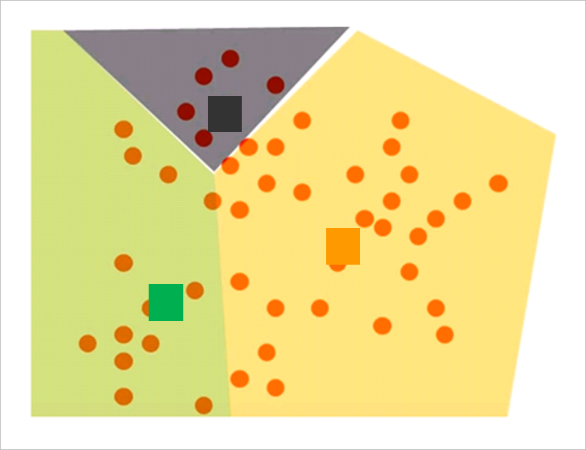
Clustering
Grouping a set of objects such that marks within each cluster are more similar to one another than they are to marks in other clusters

Slide 30
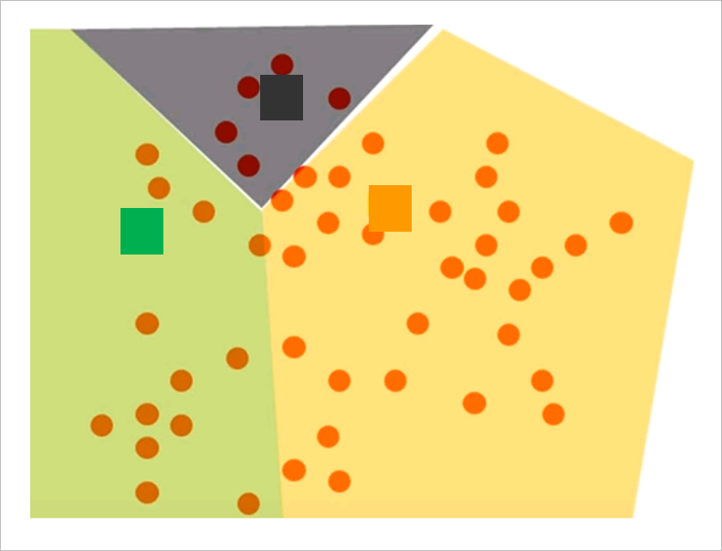
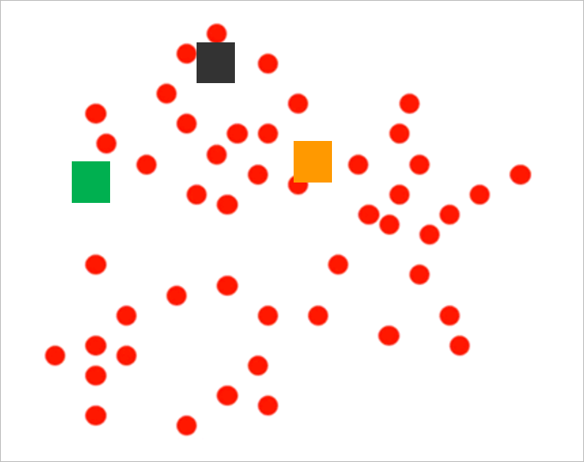
Clustering

Slide 31
Recap & Last Notes

Slide 32
Recap
Distribution
Modeling
Histograms
Percentiles
Box Plots
Control Charts
Trend Lines
Correlation Coefficients
Forecasting
Clustering

Slide 33
SESSION REPEATS
Day of Week, Month Day Think Outside the Box(plot)
Time – Time | Location
Day of Week, Month Day Think Outside the Box(plot)
Time – Time | Location

Slide 34
RELATED SESSIONS
Day of Week, Month Day Get on it, stat: Statistical analysis skills in Tableau
Time – Time | Location
Day of Week, Month Day Get on it, stat: Statistical analysis skills in Tableau
Time – Time | Location

Slide 35

Please complete the session survey from the Session Details screen in your TC17 app

